Slide 1
Decision Tree and Random Forest
Noble Xavier

Slide 2
Supervised Learning
Regression
Simple Linear Regression
Multiple Linear Regression
Decision Tree
Random Forest
Polynomial Regression
KNN Regressor
Classification
Logistic regression
k-nearest neighbour (KNN)
Naive Bayes (Classifier)
Support vector machines
Decision Tree
Random Forest

Slide 3
DECISION TREE

Slide 4
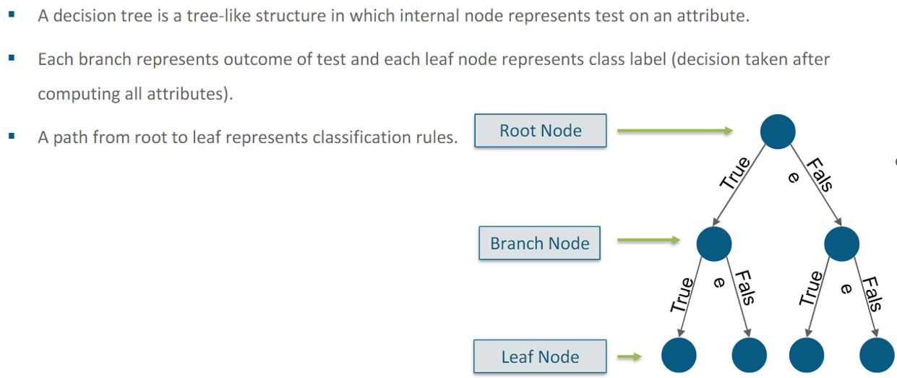
Decision Tree

Slide 5
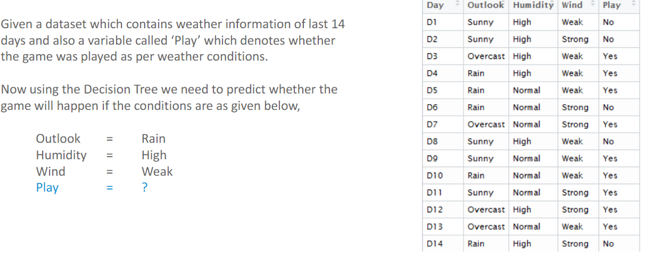
Decision Tree-Example

Slide 6
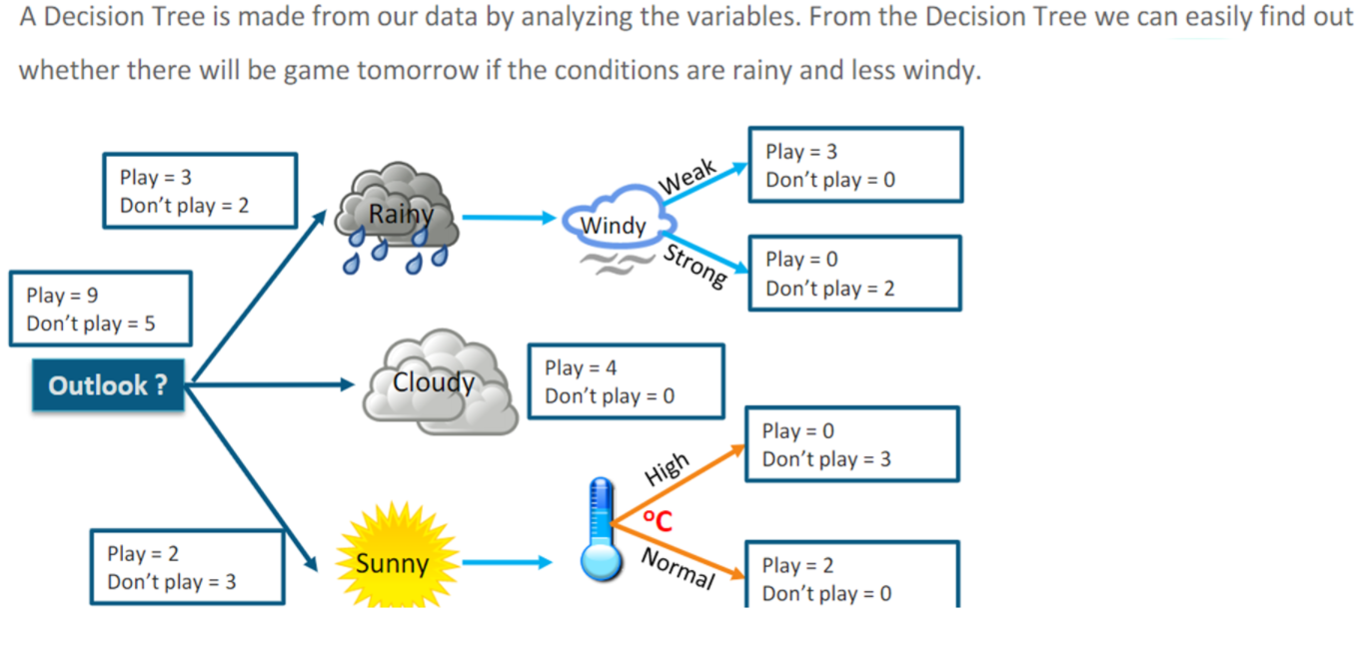
Decision Tree-Example

Slide 7
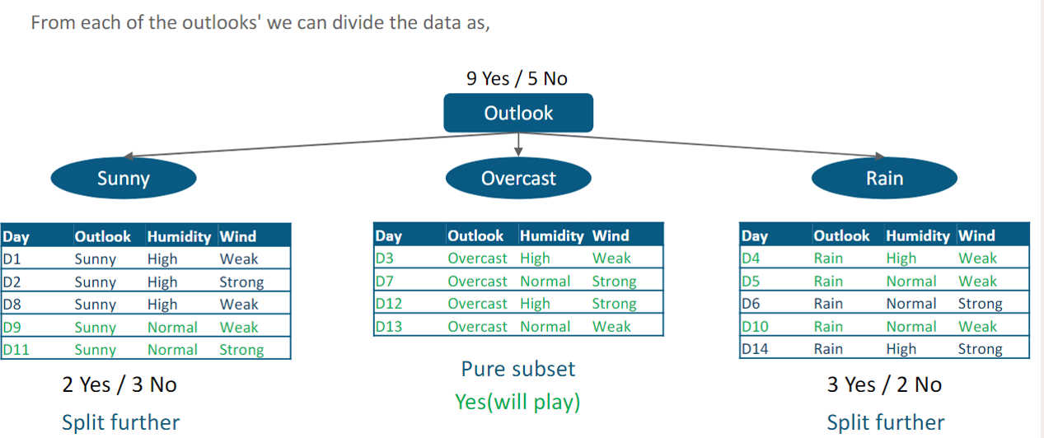
Decision Tree-Example

Slide 8
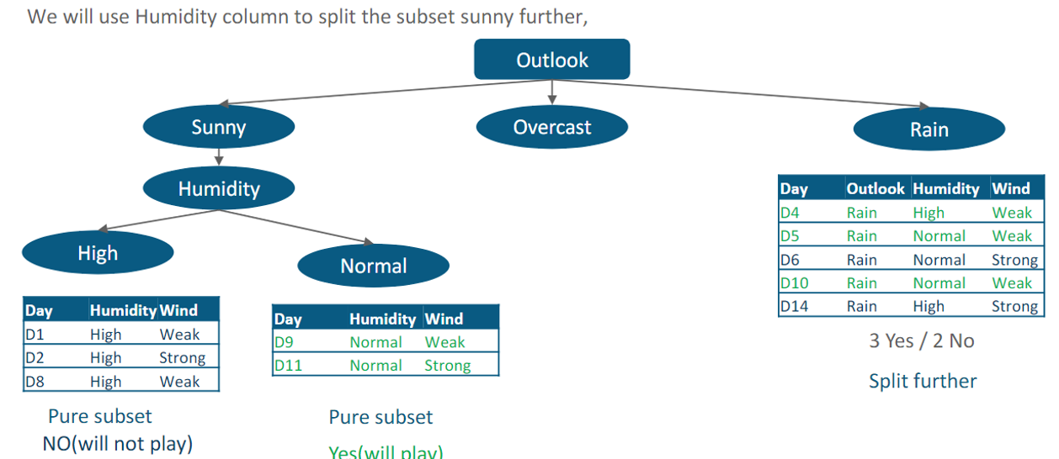
Decision Tree-Example

Slide 9
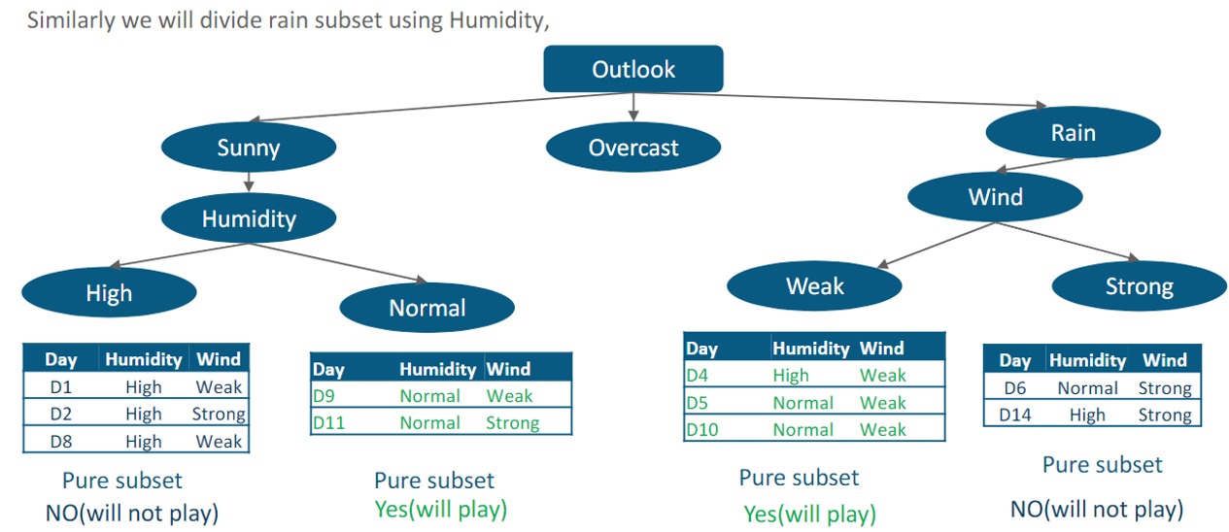
Decision Tree-Example

Slide 10
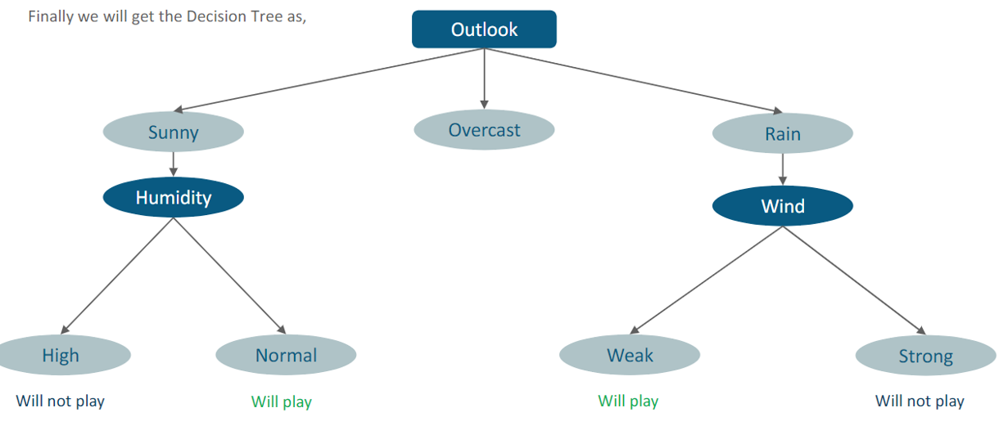
Decision Tree-Example

Slide 11
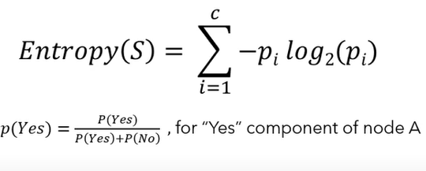
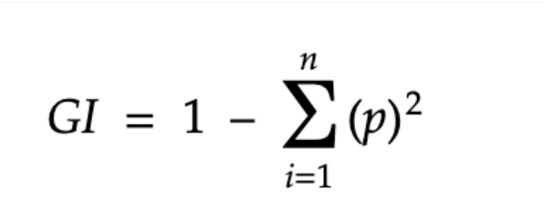
Entropy and Gini
Entropy and Gini determine how a decision tree chooses to split data
Entropy and Gini index are metrics used to determine the quality of a split in decision tree algorithms. They are calculated differently but use the same metric
The Gini index is faster and less expensive than entropy, which involves log calculations. However, entropy results are generally slightly better

Slide 12
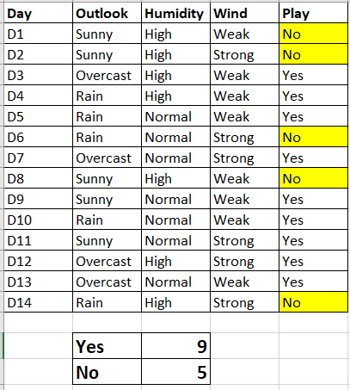
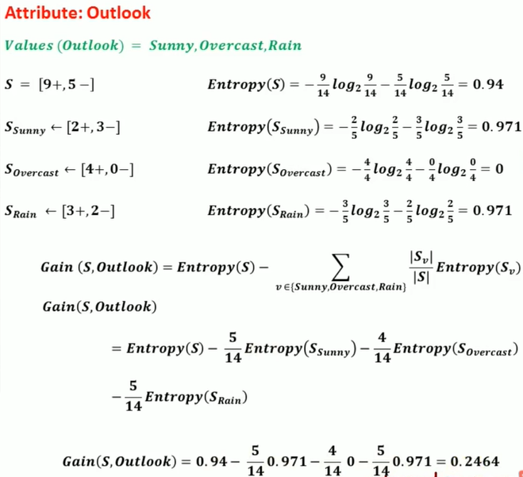
Entropy

Slide 13
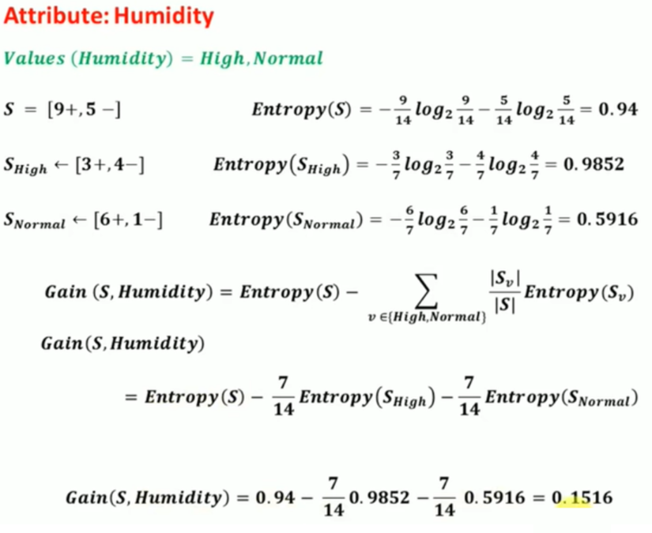
Entropy

Slide 14
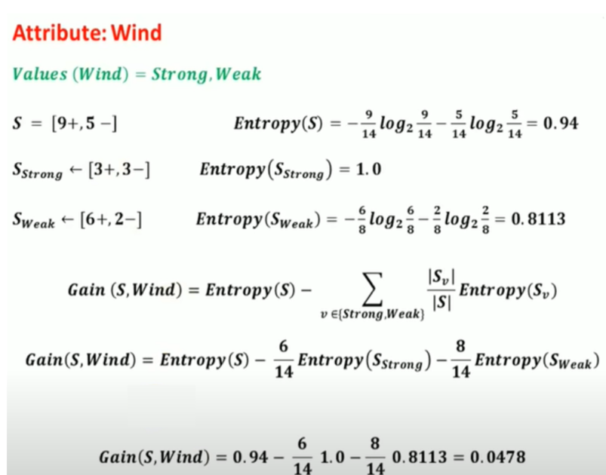
Entropy

Slide 15
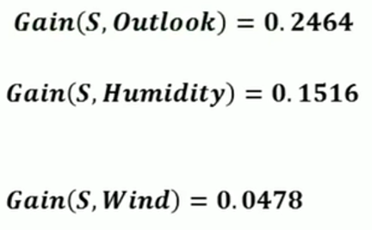
Entropy
Select the Attribute with Maximum information Gain.
In this case, Outlook is the root node

Slide 16
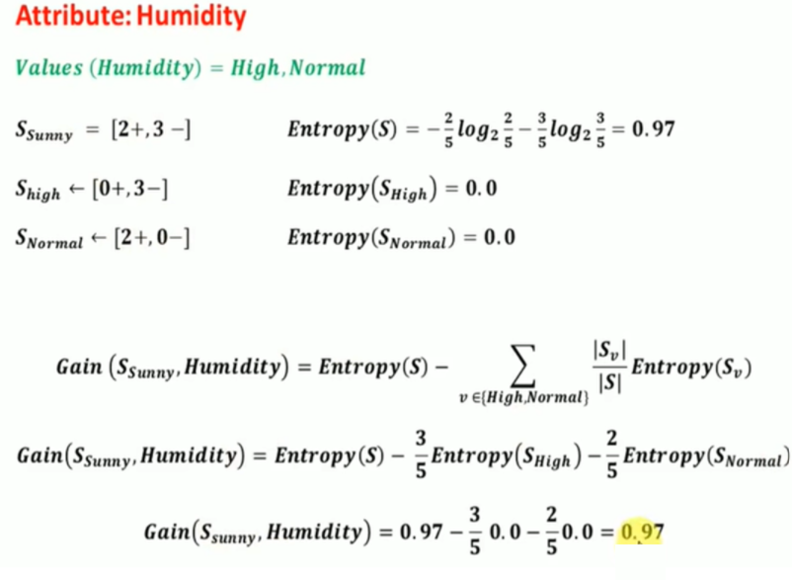
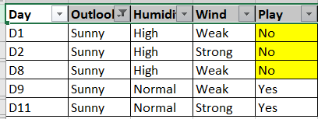
Entropy

Slide 17
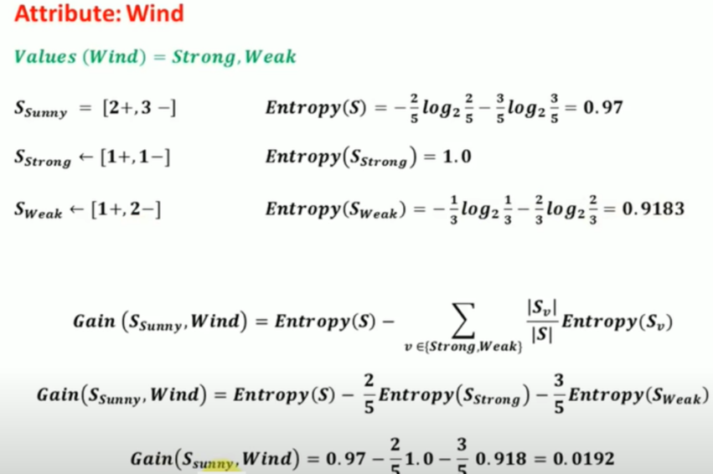
Entropy

Slide 18
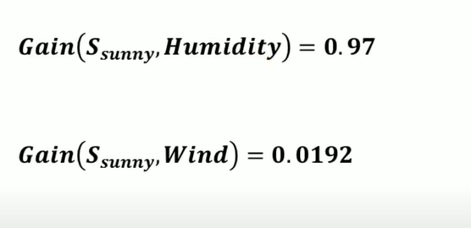
Entropy
The highest information Gain is for Humidity.
The next split is based on Humidity

Slide 19
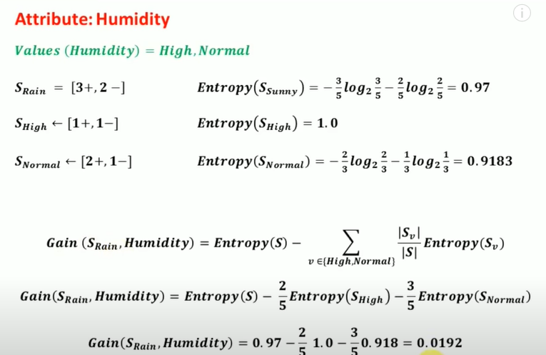
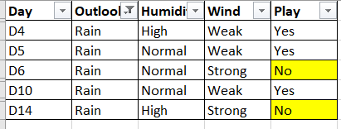
Entropy

Slide 20
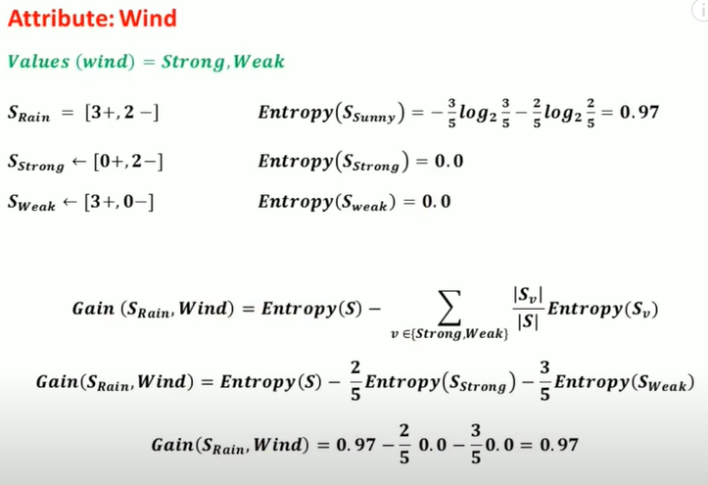
Entropy

Slide 21
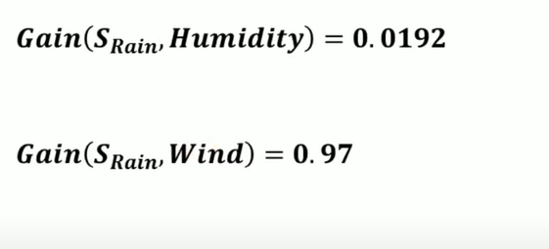
Entropy
The highest information Gain is for Wind.
The next split is based on the Wind

Slide 22
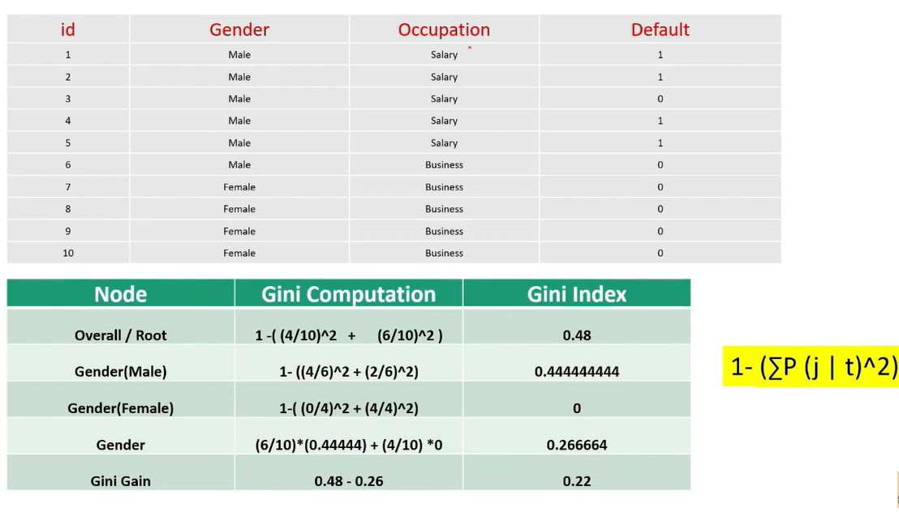
Gini
This is the Gini gain for column GENDER, similarly, calculate the Gini gain for column OCCUPATION, then split based on the maximum Gini gain value (This needs to be calculated for all independent variables before splitting

Slide 23
RANDOM FOREST

Slide 24
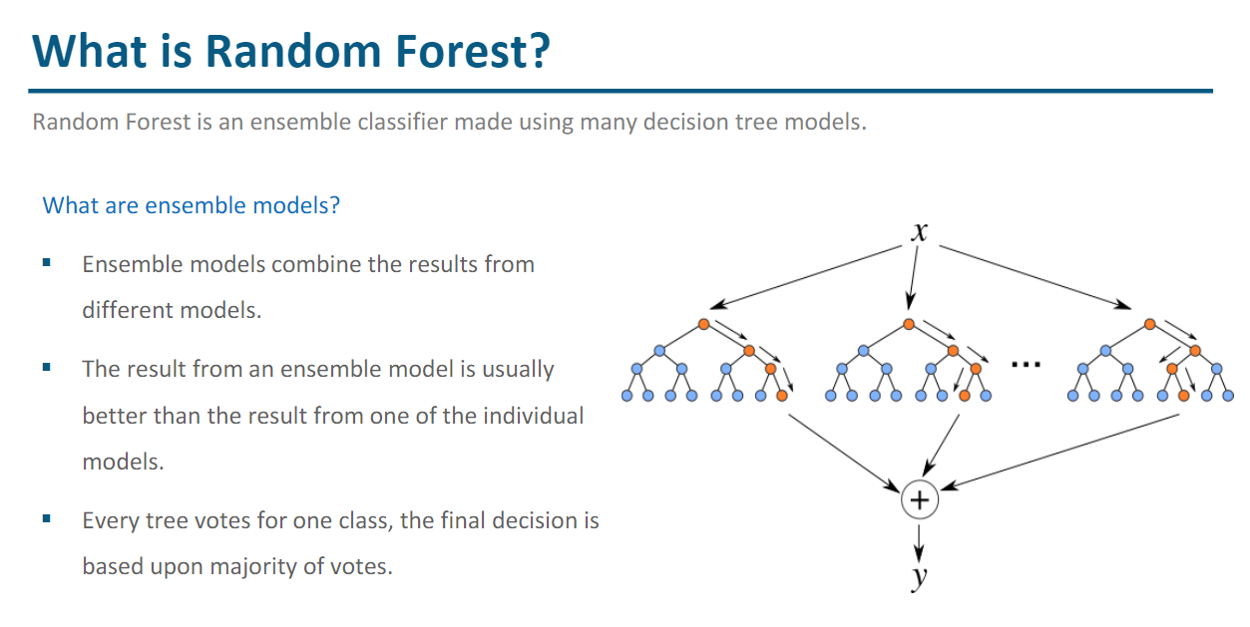

Slide 25
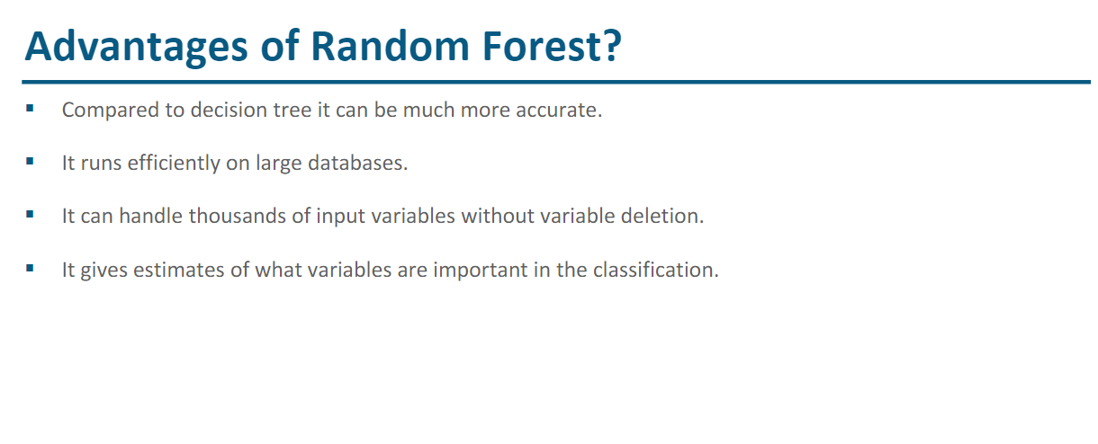

Slide 26
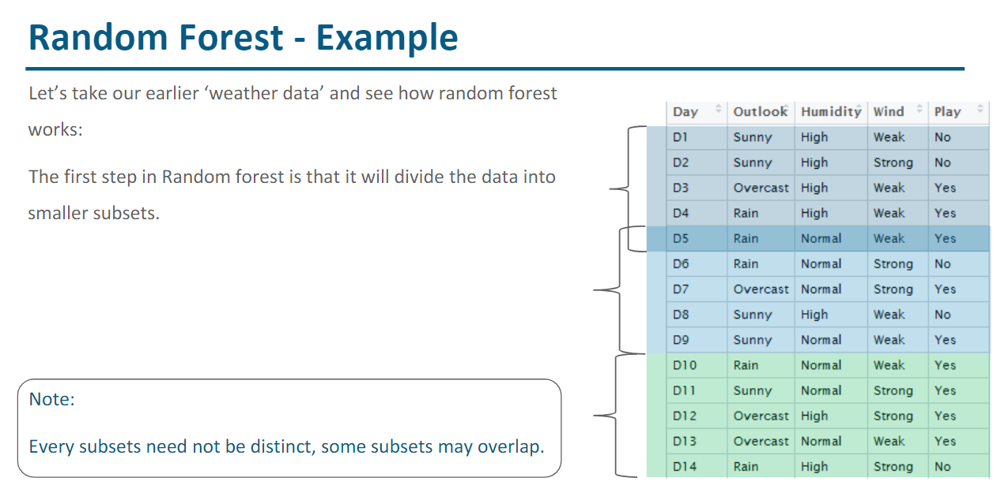

Slide 27
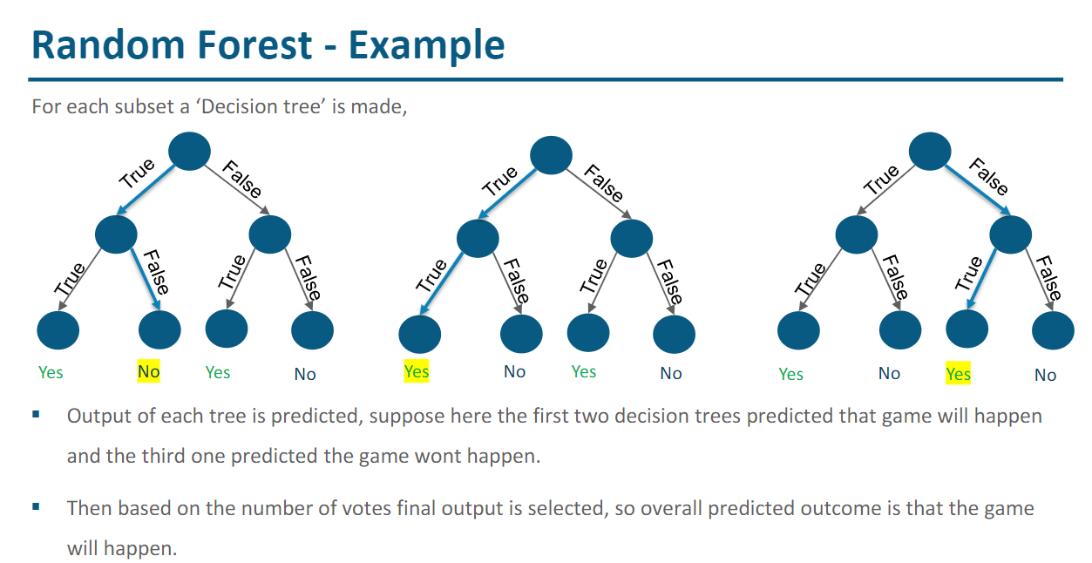

Slide 28
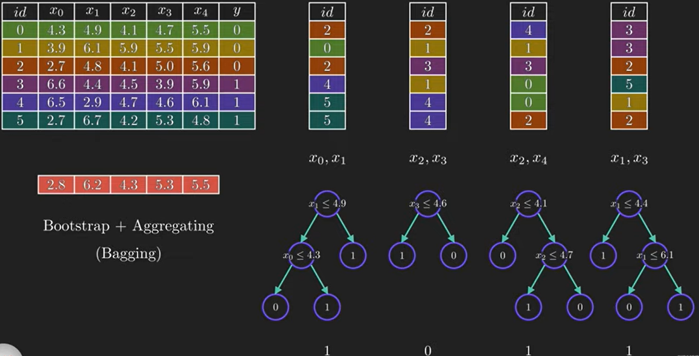
Future Data For Prediction
Random selection of Data and Random selection of Features to create Decision Tree
Majority of the prediction are 1, final result will be 1

Slide 29
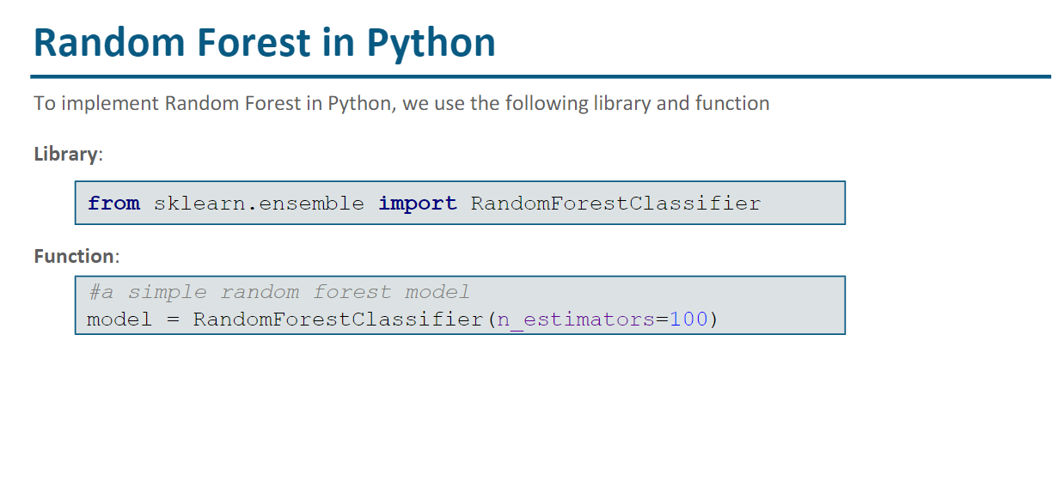

Slide 30
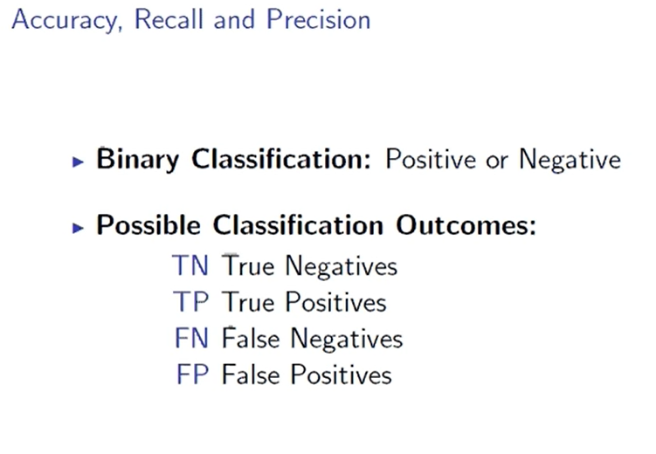
Actual : True /False
Predicted : Positive / Negative

Slide 31
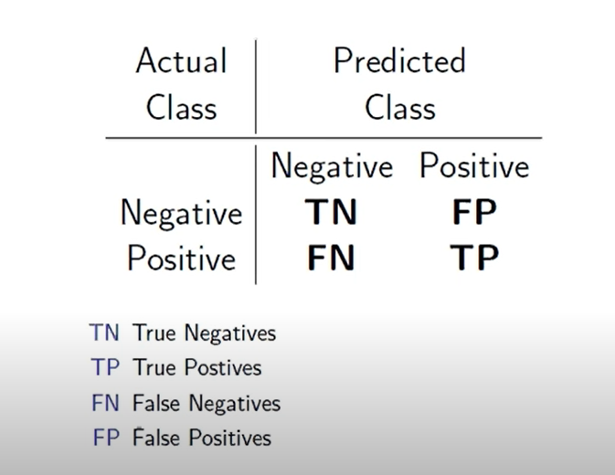

Slide 32
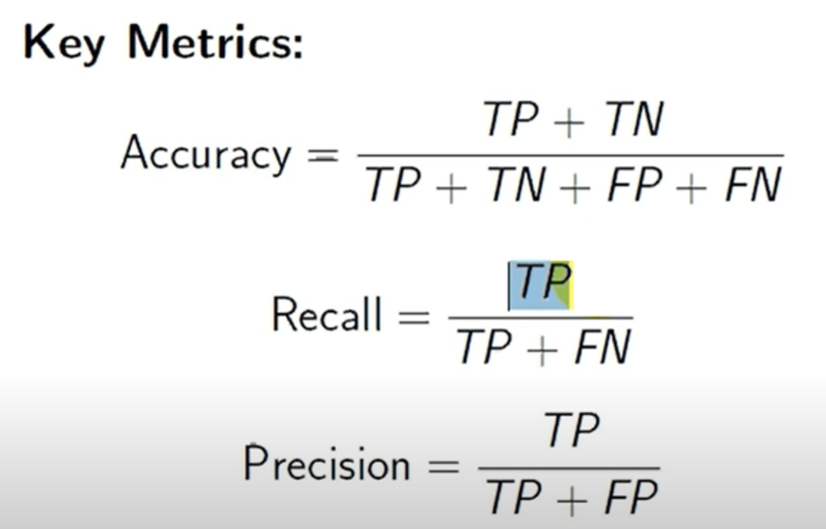

Slide 33
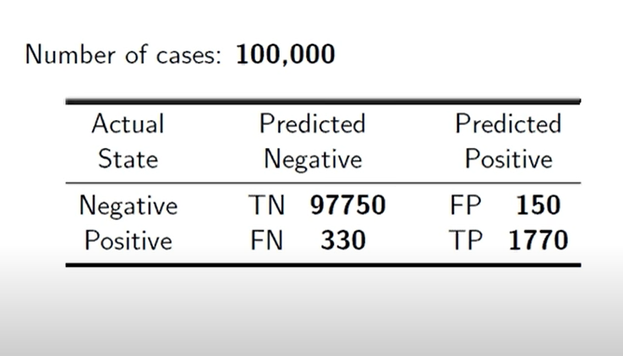

Slide 34
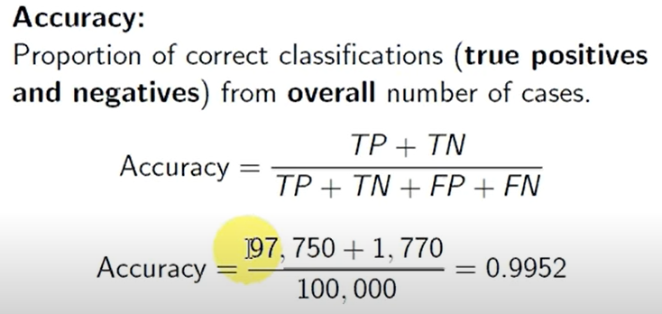

Slide 35
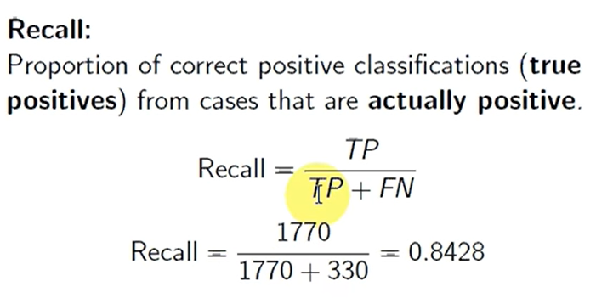

Slide 36
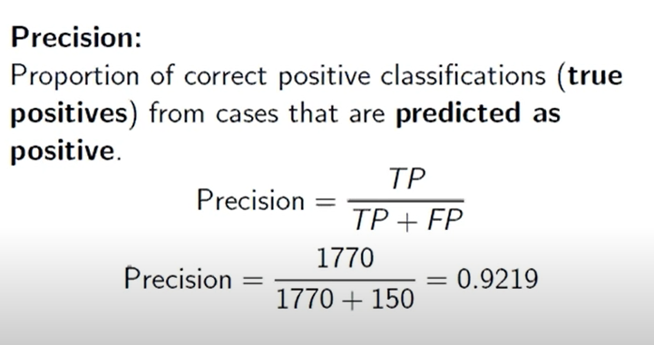

Slide 37
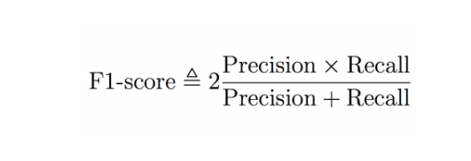

Slide 38
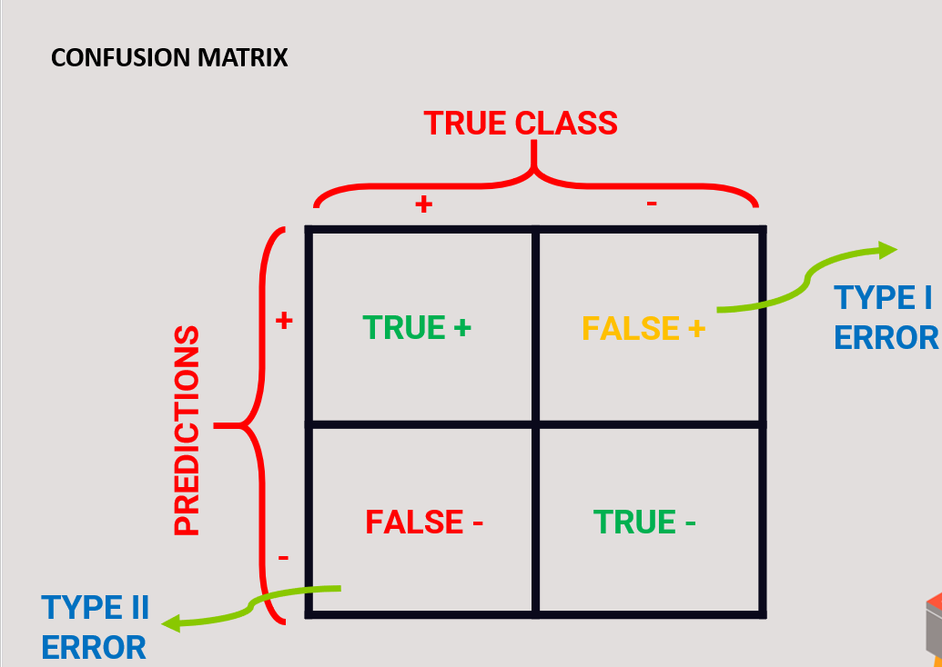

Slide 39
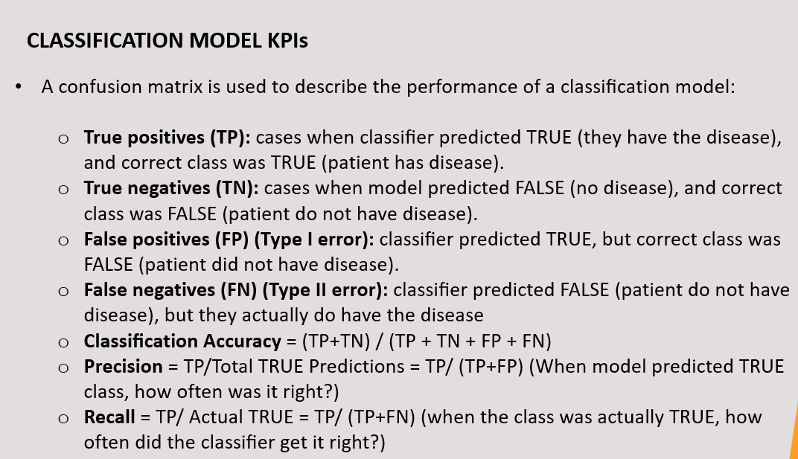

Slide 40
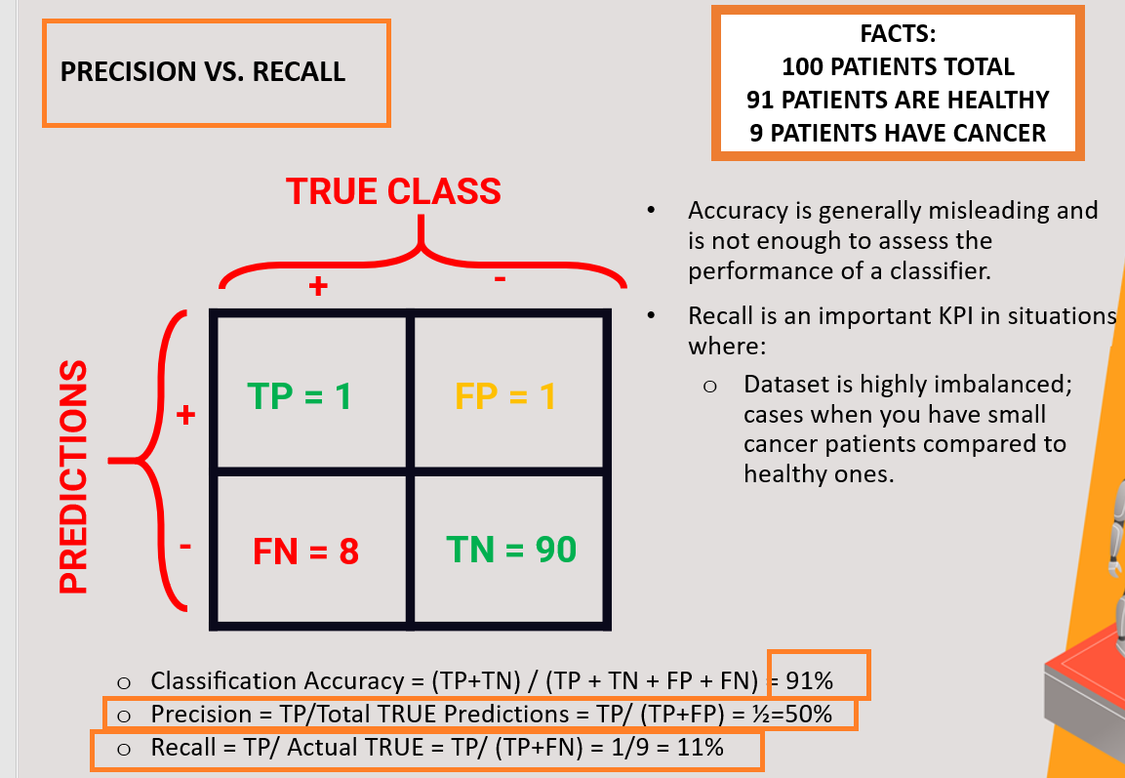

Slide 41
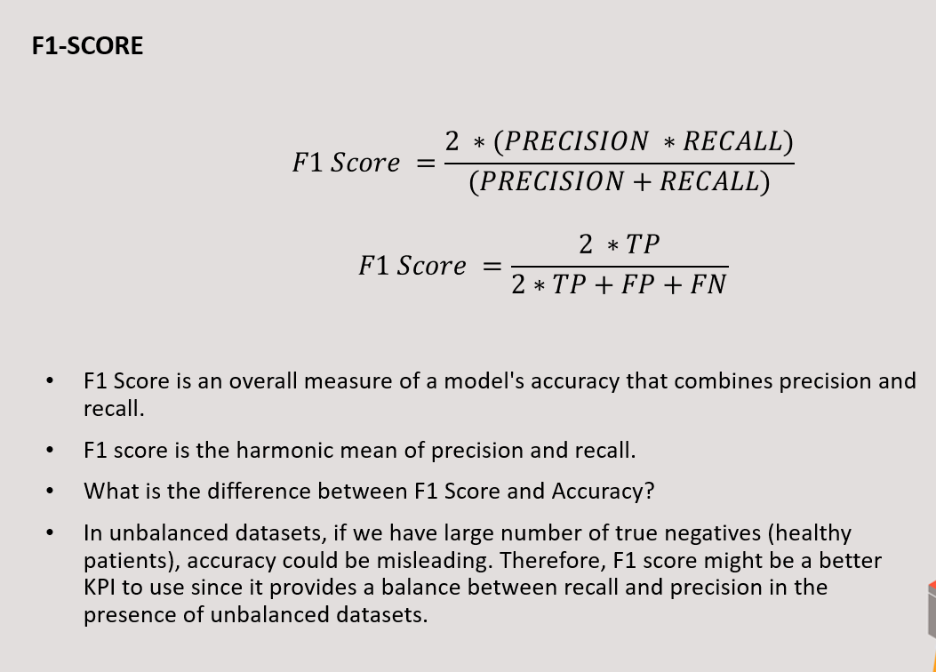

Slide 42
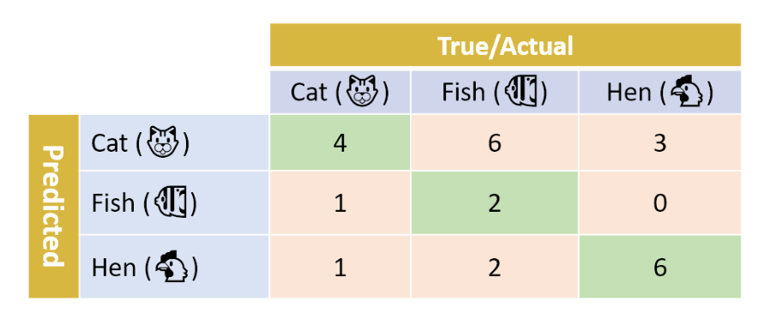
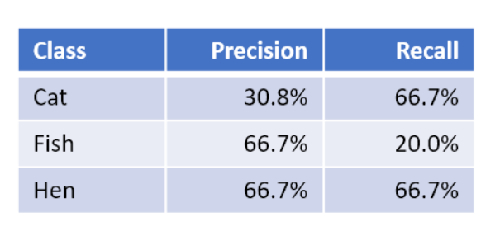

Slide 43
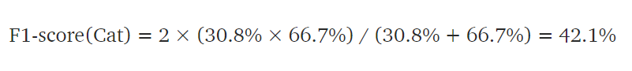
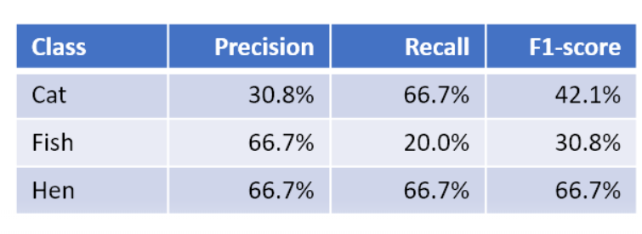

Slide 44
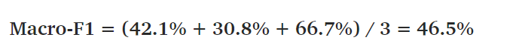
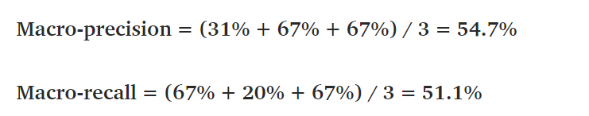
Macro-F1: Mean of our per-class F1-scores

Slide 45
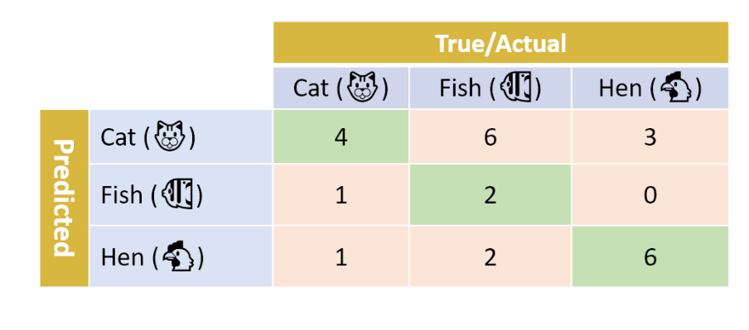
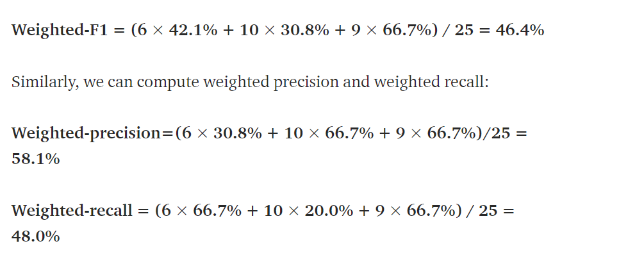
Weighted-average F1-score: weight the F1-score of each class by the number of samples from that class. In our case, we have a total of 25 samples: 6 Cat, 10 Fish, and 9 Hen. The weighted-F1 score is thus computed as follows:

